Slide 1

Linear Search And Binary Search

Slide 2
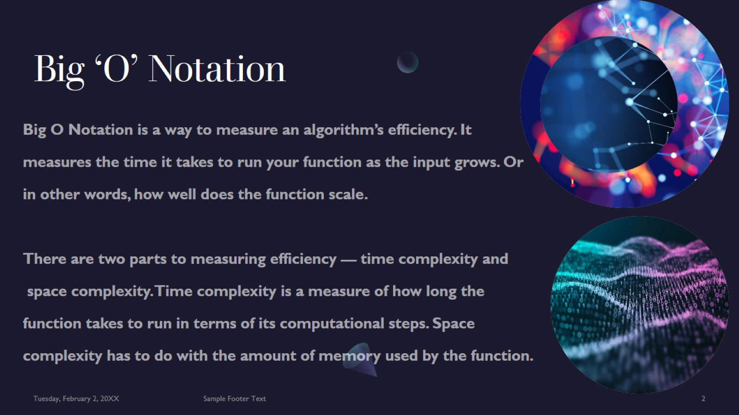
Big ‘O’ Notation

Slide 3
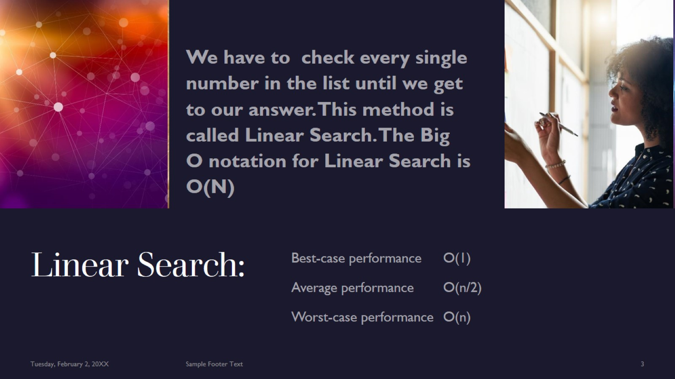
Linear Search:

Slide 4
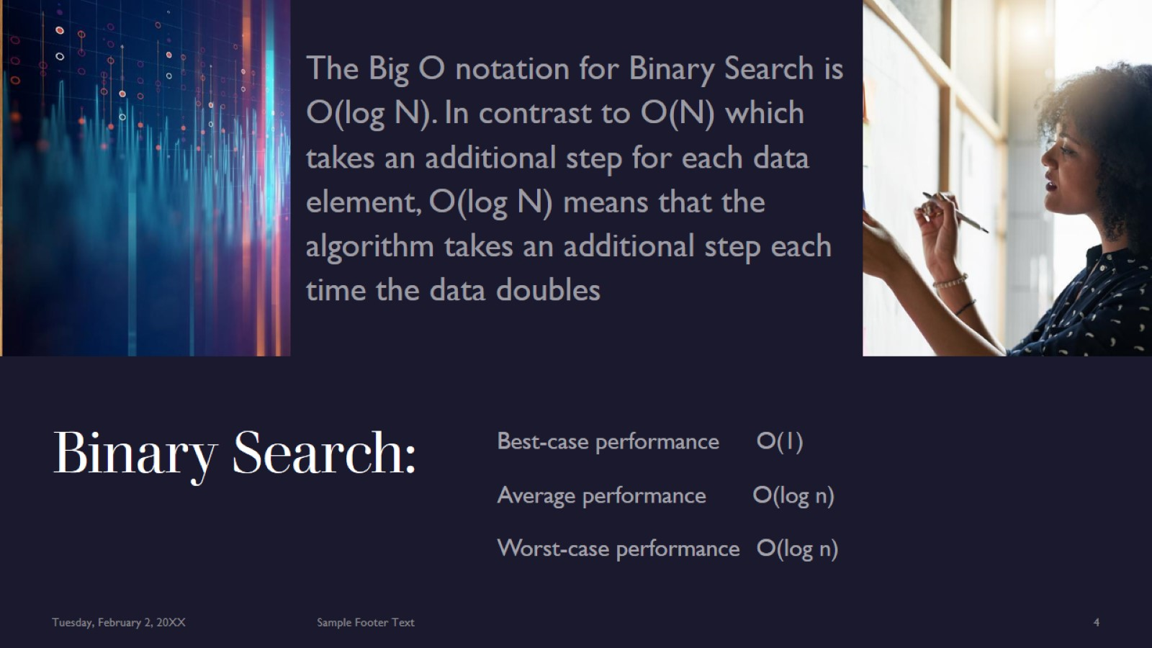
Binary Search:

Slide 5

Thank You

